Slide 1
Digital Design and Computer Architecture
Course outcome 2

Slide 2
PROJECT TITLE
Automated Street Light Control System

Slide 3
Presented by
1.Sai Hitesh – 2620030269
2. Hyder – 2620030257
3. Radhika – 2620030258
4. Akshith - 2620030282

Slide 4
Objectives
The objective of this project is to design an automated street light system that switches ON when it is dark and motion is detected, and switches OFF when it is bright or no motion is detected. This system helps save electricity and reduces manual operation.
Specific Objectives:
Automatic Control – turns the street light ON or OFF based on light conditions and motion detection.
Energy Saving – reduces unnecessary electricity consumption.
Motion Detection – activates the light only when movement is detected in darkness.
Cost Reduction – minimizes power wastage and electricity bills.
Improved Efficiency – provides smart and reliable street light control.

Slide 5
Logic Design
The system uses two inputs and one output.
Input A – LDR Sensor: 0 = Dark, 1 = Bright.
Input B – Motion Sensor: 0 = No motion, 1 = Motion detected.
Output Y – Street Light: 0 = OFF, 1 = ON.

Slide 6
Logic gates used:
NOT Gate – converts A = 0 (dark) into 1.
AND Gate – checks whether it is dark and motion is detected.
LED/Output – indicates whether the street light is ON or OFF.

Slide 7
Working
The LDR sensor detects the surrounding light intensity.
If it is dark, input A becomes 0, and the NOT gate converts it to 1.
The motion sensor checks whether a person or vehicle is nearby.
The AND gate receives the inverted LDR signal and the motion sensor signal.
If both signals are 1, the street light turns ON.
If it is bright or no motion is detected, the street light remains OFF.

Slide 8
Simulation
The circuit can be simulated using Logisim Evolution.
Place two input pins, one NOT gate, one AND gate, and one output pin.
Connect input A to the NOT gate.
Connect the NOT gate output to one input of the AND gate.
Connect input B to the other input of the AND gate.
Connect the AND gate output to the output pin Y.
Change the input values and verify the output using the truth table.

Slide 9
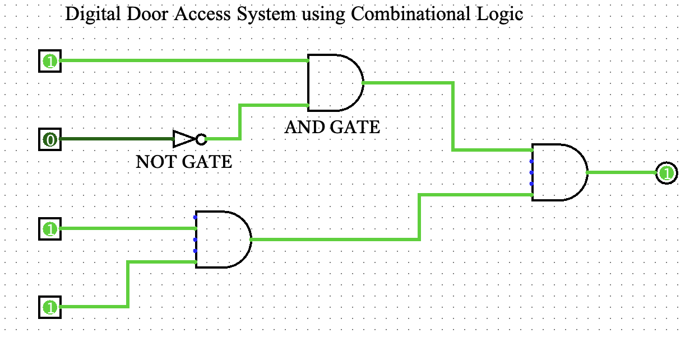

Slide 10
Truth table
Boolean expression: Y = A'B
A = LDR sensor (0 = Dark, 1 = Bright)
B = Motion sensor (0 = No motion, 1 = Motion detected)
Y = Street light (0 = OFF, 1 = ON)
A | B | Y (Light)
0 | 0 | 0
0 | 1 | 1
1 | 0 | 0
1 | 1 | 0

Slide 11
Expected Result
The street light turns ON when it is dark and motion is detected.
The street light remains OFF during daylight or when no motion is detected.
The system helps save electricity by reducing unnecessary power consumption.

Slide 12
THANK YOU

